Slide 1
MULTI MODAL APPROACH OF SPEECH EMOTION RECOGNITION USING MULTI LEVEL MULTI HEAD FUSION ATTENTION BASED RNN
AUTHORS:
1.NGOC-HUYNH HO 2.HYUNG-JEONG YANG
3.SOO-HYUNG KIM 4.GUEESANG LEE
PUBLISHED ON:30TH MARCH 2020
DEPARTMENT OF ELECTRONICS AND COMPUTER ENGINEERING, CHONNAM NATIONAL UNIVERSITY, GWANGJU 61186, SOUTH KOREA
OUR TEAM:
BOTTA PRUDHVEE RAJ-1806054
PRATTIPATI KRISHNA KUMAR-1806114
PADALA SHASHANK-1806119

Slide 2


PROBLEM STATEMENT:
Speech emotion recognition is a challenging but important task in human computer interaction(HCI). As technology and understanding of emotion are progressing, it is necessary to design robust and reliable emotion recognition systems that are suitable for real-world applications both to enhance analytical abilities supporting human decision making and to design human–machine interfaces (HMI) that assist efficient communication.

Slide 3
Quick Overview of the code
1.Preprocessing of text by using BERT
2.Preprocessing of Audio using librosa
3.Self Attention for Both audio and text data
4.Multi Head Attention
5.Dense Layers
6.Softmax

Slide 4
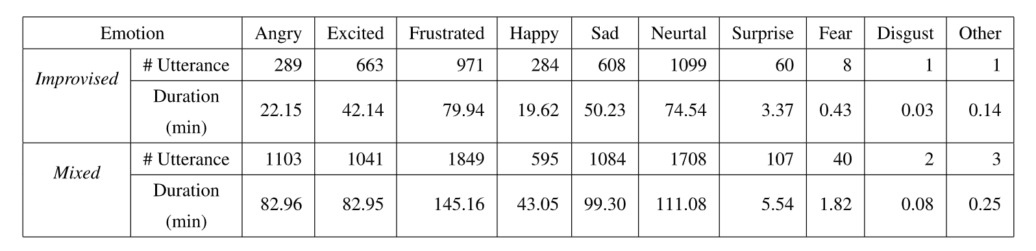
DATASET-IEMOCAP
IEMOCAP dataset consists of approximately twelve hours of recordings
Audio, video and facial key points data was captured during the five sessions. Each session is a sequence of dialogues between man and woman
All involved people are professional actors and actresses from Drama Department of University of Southern California
The evaluation form contained ten options:neutral,happiness,sadness,anger,sur-prise,fear,disgust,frustration,excitation, and other. The total length is around 12 hours.
In improvise subjects were asked to improvise based on hypothetical scenarios while in the Scripted one, subjects were asked to memorize and rehearse with scripts
The Mixed scenario means we combine both improvised and scripted scenarios to cover a full range of situations

Slide 5
PREPROCESSING FOR TEXT DATA
Our first step is to tokenize the sentences -- break them up into word and sub words in the format BERT is comfortable with.
After tokenization, tokenized is a list of sentences -- each sentences is represented as a list of tokens. We want BERT to process our examples for that reason, we need to pad all lists to the same size, so we can represent the input as one 2-d array, rather than a list of lists (of different lengths).
If we directly send padded to BERT, that will slightly confuse it. We need to create another variable to tell it to ignore (mask) the padding we've added when it's processing its input. That's what attention mask is:
The model() function runs our sentences through BERT. The results of the processing will be returned into the variable we have taken.

Slide 6
PREPROCESSING FOR AUDIO DATA
Conversion of Raw audio data to audio signal of sample rate16000 using librosa
We set audio frames of 100ms sampled at a rate of 50ms using hamming window
We extracted a total of 39 features in which the first feature is log energy of sound and then 12 MFCCS(1-12) from 26 Mel frequency bands (frequency range of Mel spectrum is set to 0-8Khz) and applies cepstral liftering filter with a weighted parameter of 22 and then 13-delta and 13-accerlation coefficients .
These features are mean normalized with respect to full input sequence

Slide 7
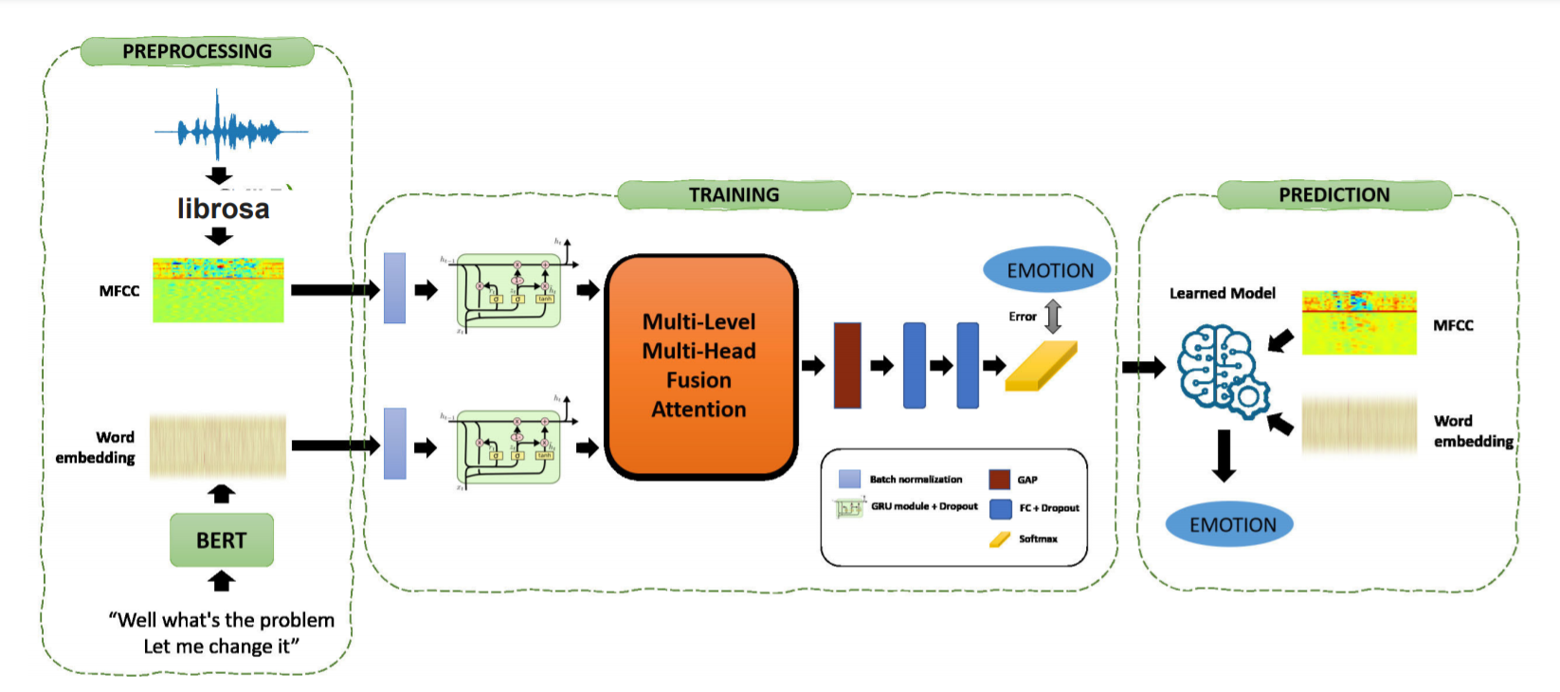
Number of layers in Gru for audio data are 78 Number of layers in Gru for Text data are 192 Each FC layer consists 80 perceptron's and its activation function is Fast GELU fastGelu(x)=max(0,min(1,(1.702*x+1)/2))*x

Slide 8
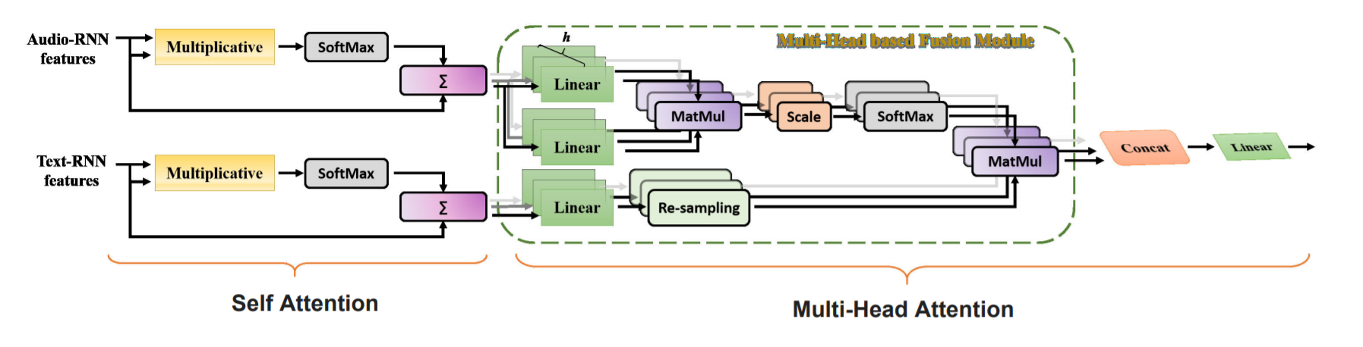
Multi-Level Multi-Head Fusion Attention (MMFA) consisting of two levels. Multiplicative: multiplicative operation;Softmax: SoftMax function;∑: dot-product summation;Concat: feature concatenation; Linear: lineartransformation;MulMat: dot-product operation; Scale: scaled operation; Re-sampling: interpolation technique.

Slide 9
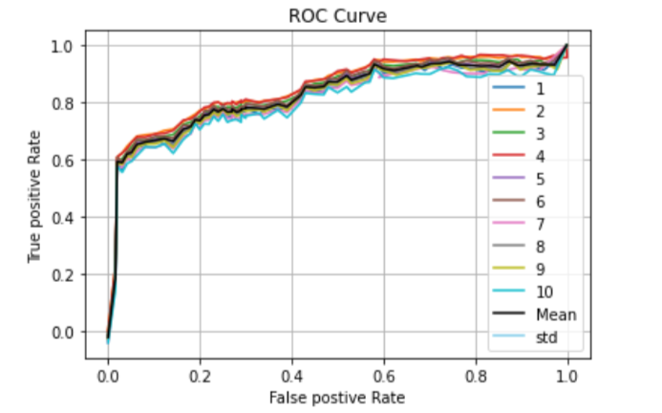
RESULTS AND DIFFERENCES 1.we have used librosa in place of Open smile 2.Researches has done batch wise padding but we have done padding to the whole dataset at a time.
Researcher's Model | Accuracy | Precession | Recall | F-beta
Multi-Modal | 73.23+/-4.07 | 74.26+/-4.22 | 73.23+/-4.07 | 73.7+/-4
Our model | Accuracy | Precession | Recall | F-beta
Multi-Modal | 65.56+/-2.07 | 66.34+/-2.52 | 64.31+/-2.14 | 66.23+/-1.32

Slide 10




THANK YOU

